Slide 1



BStack DEMO
UNDER GUIDENCE OF MRS.VAISHALI SONANIS MAM.

Slide 2

INTRODUCTION
BrowserStack DEMO is a mobile e-commerce testing platform that allows developers and testers to test websites and mobile applications across different browsers, operating systems, and real devices.

Slide 3

OVERVIEW
What is BStack?
Browser Stack is a cloud-based testing platform that enables developers and testers to test websites and mobile applications on real browsers and devices without maintaining physical infrastructure.
My project is a demo setup using Browser Stack.
It helps users understand how cross-browser and cross-device testing works.
Browser Stack provides instant access to thousands of browsers, operating systems, and mobile devices.
It supports both manual and automated testing, with integrations for Selenium, TestNG, Cucumber and Jenkins tools.

Slide 4

MODULES
MODULE 1 :
LOGIN
Checked the functionalities of username and password in the sign in page for login
MODULE 2 : SEARCH
Checked the functionality of search field and button by giving search input .
MODULE 3 :BRAND SHOPPING
Checked the functionality of shopping by selecting brands like Apple, Samsung, Google, OnePlus.

Slide 5
MODULES
MODULE 4 :
FAVOURITES
Checked the functionality of favourites by adding an item to favourite’s list
MODULE 5 : CART
Checked the functionalities of cart like adding an item to cart and deleting button in cart
MODULE 6 : CHECKOUT
Checked the functionalities of checkout button
MODULE 7 : SHIPPING ADDRESS
Checked all the field functionalities of Shipping Address like First name, Last name, address line, state, postal code.

Slide 6
MODULES
MODULE 8 : ORDER RECEIPT and CONTINUE
Checked the functionality of Order Receipt download and Continue buttons
MODULE 9 : FILTERS
Checked the functionality of Filters like selecting low to high and selecting high to low buttons.
MODULE 10 : PRIVACY POLICY
Checked the functionality of privacy policy read more button
MODULE 11 : BROWSE OFFERS
Checked the functionality of offers button and validate message in that page
MODULE 12 : LOGOUT
Checked the functionality of logout button

Slide 7
DEFECTS
Search Engine is not working
No message is displayed in Favourites page even though the list is empty
Shipping address fields are accepting any inputs
Privacy Policy Read More is not navigating to policy page

Slide 8
Defect identifier :- D_001
DEFECT SUMMARY : - Expected result is when "Search" is used for an input Product list should show it's related products but it is navigating to home page. Therefore "Search engine" is not working and No Length limit for input
TEST ID :- TC_001,TC_002,TC_004,TC_006
TEST CASE NAME :- TC-BStack-Search-Valid, TC-BStack-Search-Invalid, BStack-Search-Partial Match, TC-BStack-Search-Max Length
MODULE NAME :- Search
REPRODUCIBLE :- when we search iPhone in search Product list shows iPhone or related products
SEVERITY :- HIGH
PRIORITY :- HIGH
RAISED BY :- G.Nasir Hussain
ASSIGNED TO :- DEVELOPER
DATE OF ASSIGNMENT :-
STATUS :- PENDING
FIXED BY :- DEVELOPER
DATE OF FIXING :-

Slide 9
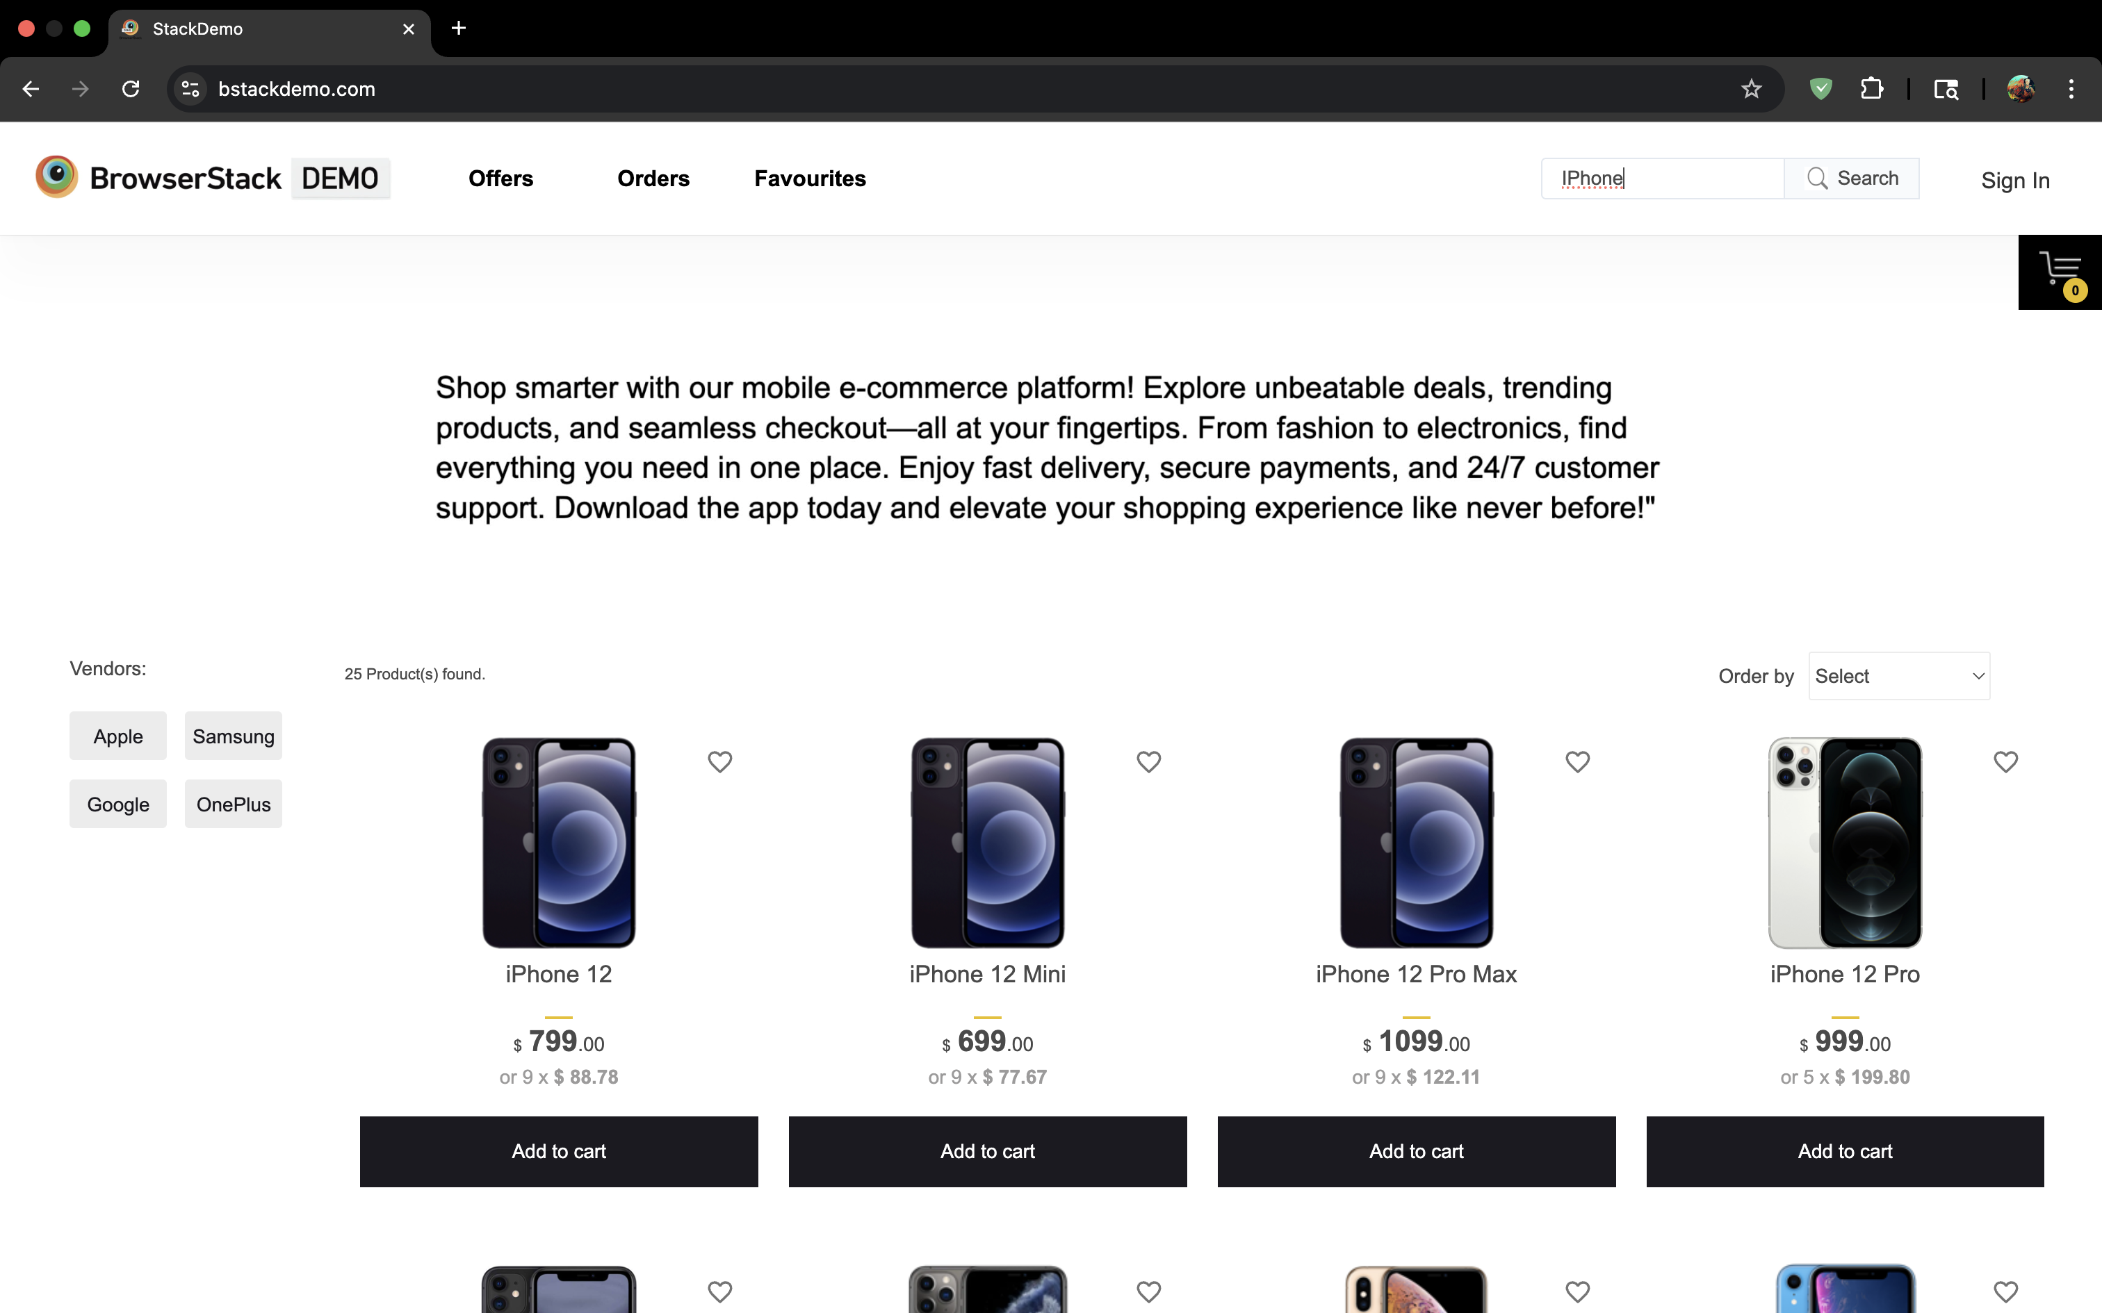
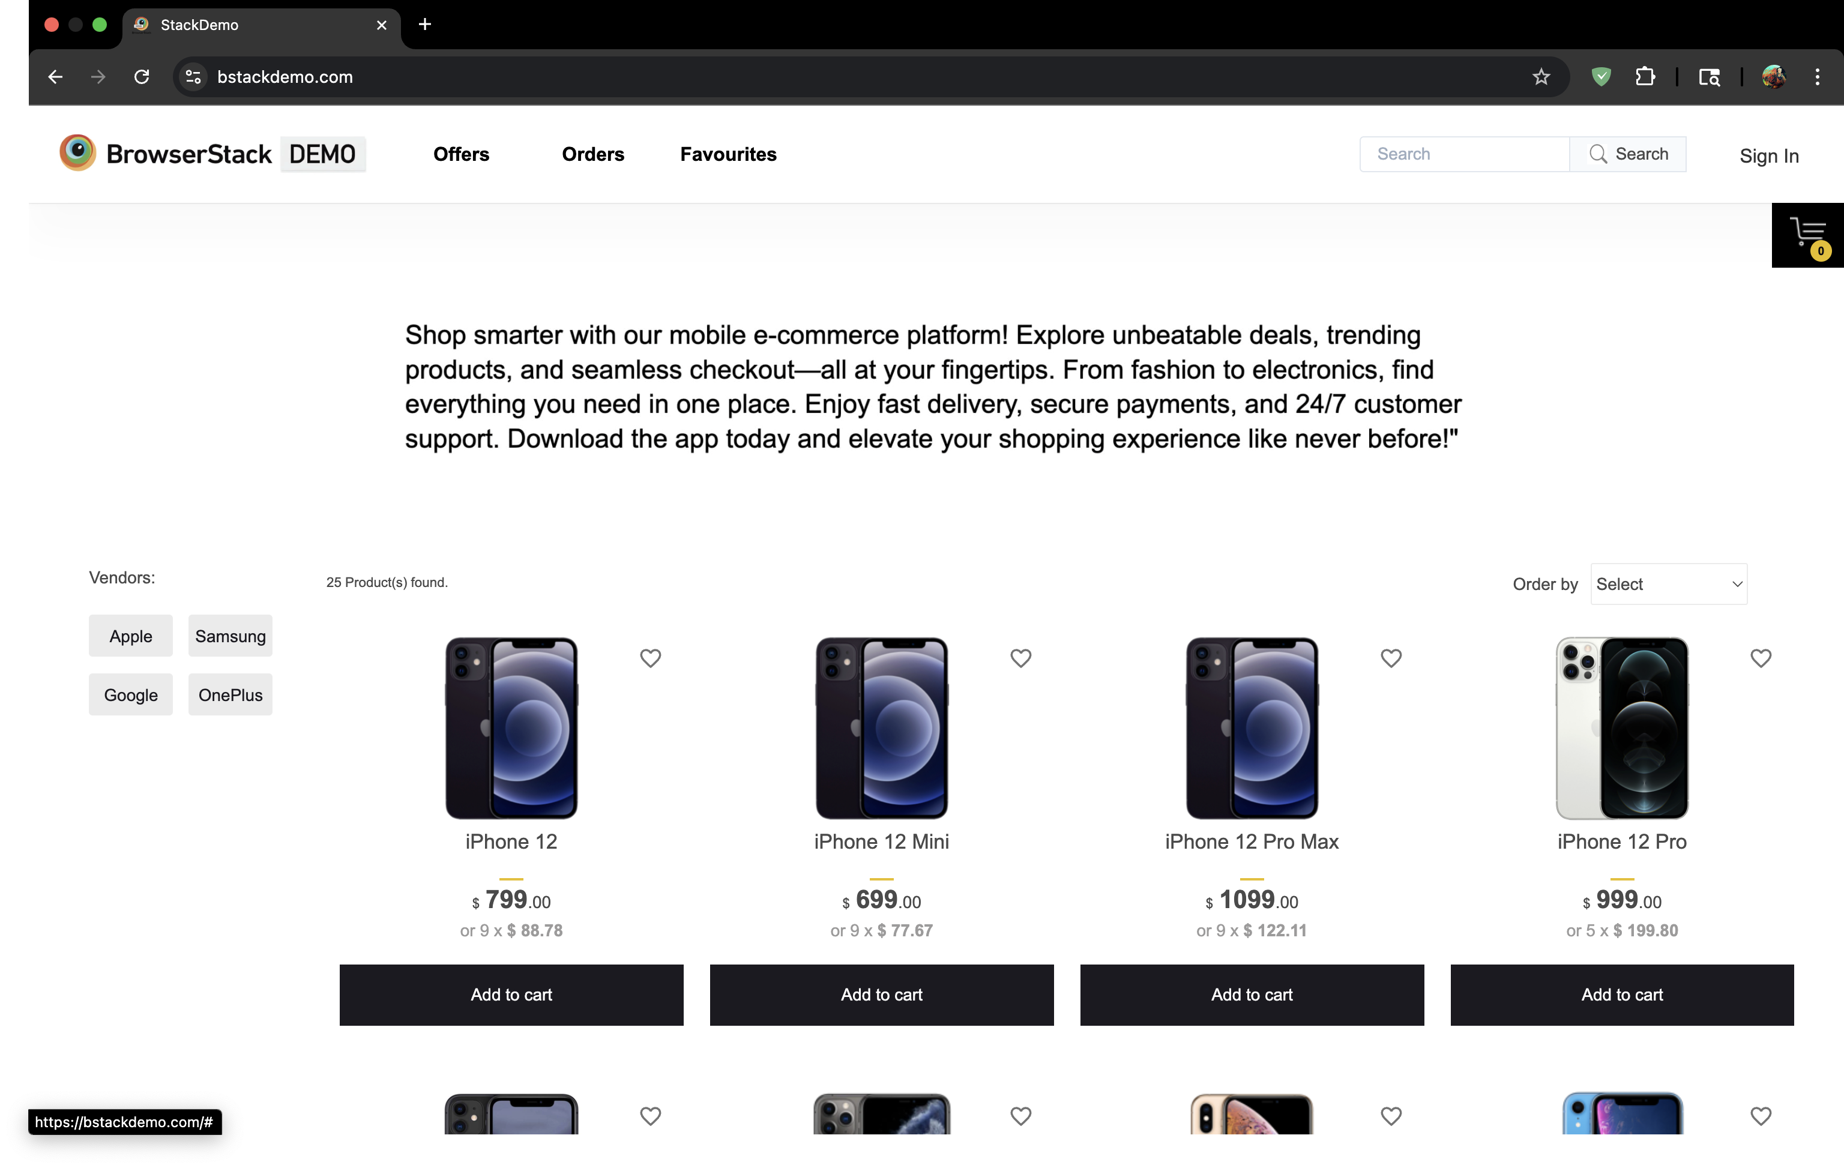
Navigating back to home page

Slide 10
Defect identifier :- D_005
DEFECT SUMMARY : - Expected result is that a Message "No items in your favorites" should be displayed. But that's not the case page is not diplaying any message related to No items
TEST ID :- TC_007
TEST CASE NAME :- TC‑BStack‑Favorites‑EmptyState
MODULE NAME :- Favourites
REPRODUCIBLE :- correct message is displayed when there are no items in Favorites like "No items in your favorites"
SEVERITY :- LOW
PRIORITY :- LOW
RAISED BY :- G.Nasir Hussain
ASSIGNED TO :- DEVELOPER
DATE OF ASSIGNMENT :-
STATUS :- PENDING
FIXED BY :- DEVELOPER
DATE OF FIXING :-

Slide 11
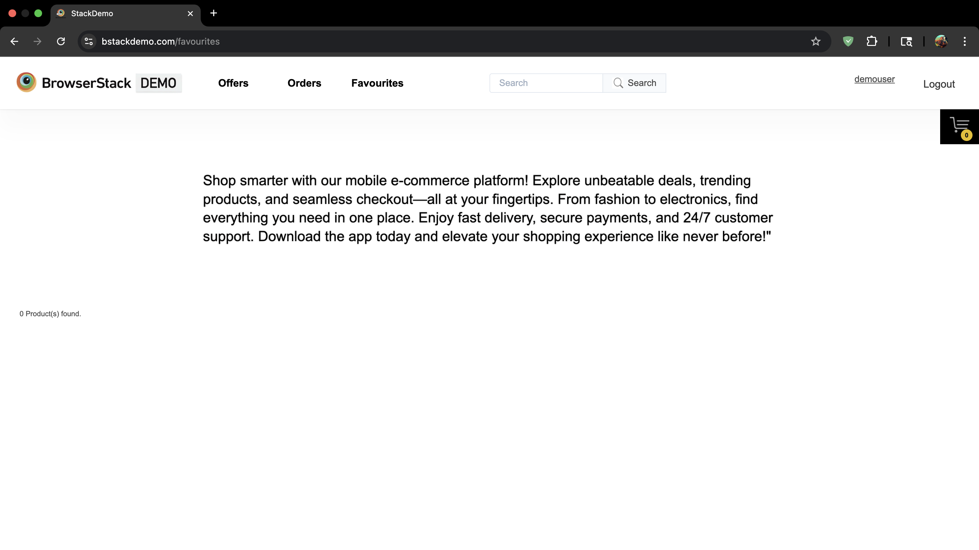

Slide 12
Defect identifier :- D_006
DEFECT SUMMARY : - Expected Result is that Error message should be displayed. And Form should not proceed further. But It's accepting even invalid input
TEST ID :- TC_003
TEST CASE NAME :- TC-B Stack-Shipping-Invalid Postal
MODULE NAME :- Shipping Address
REPRODUCIBLE :- Error message should be displayed. Form should not proceed further.
SEVERITY :- HIGH
PRIORITY :- HIGH
RAISED BY :- G.Nasir Hussain
ASSIGNED TO :- DEVELOPER
DATE OF ASSIGNMENT :-
STATUS :- PENDING
FIXED BY :- DEVELOPER
DATE OF FIXING :-

Slide 13
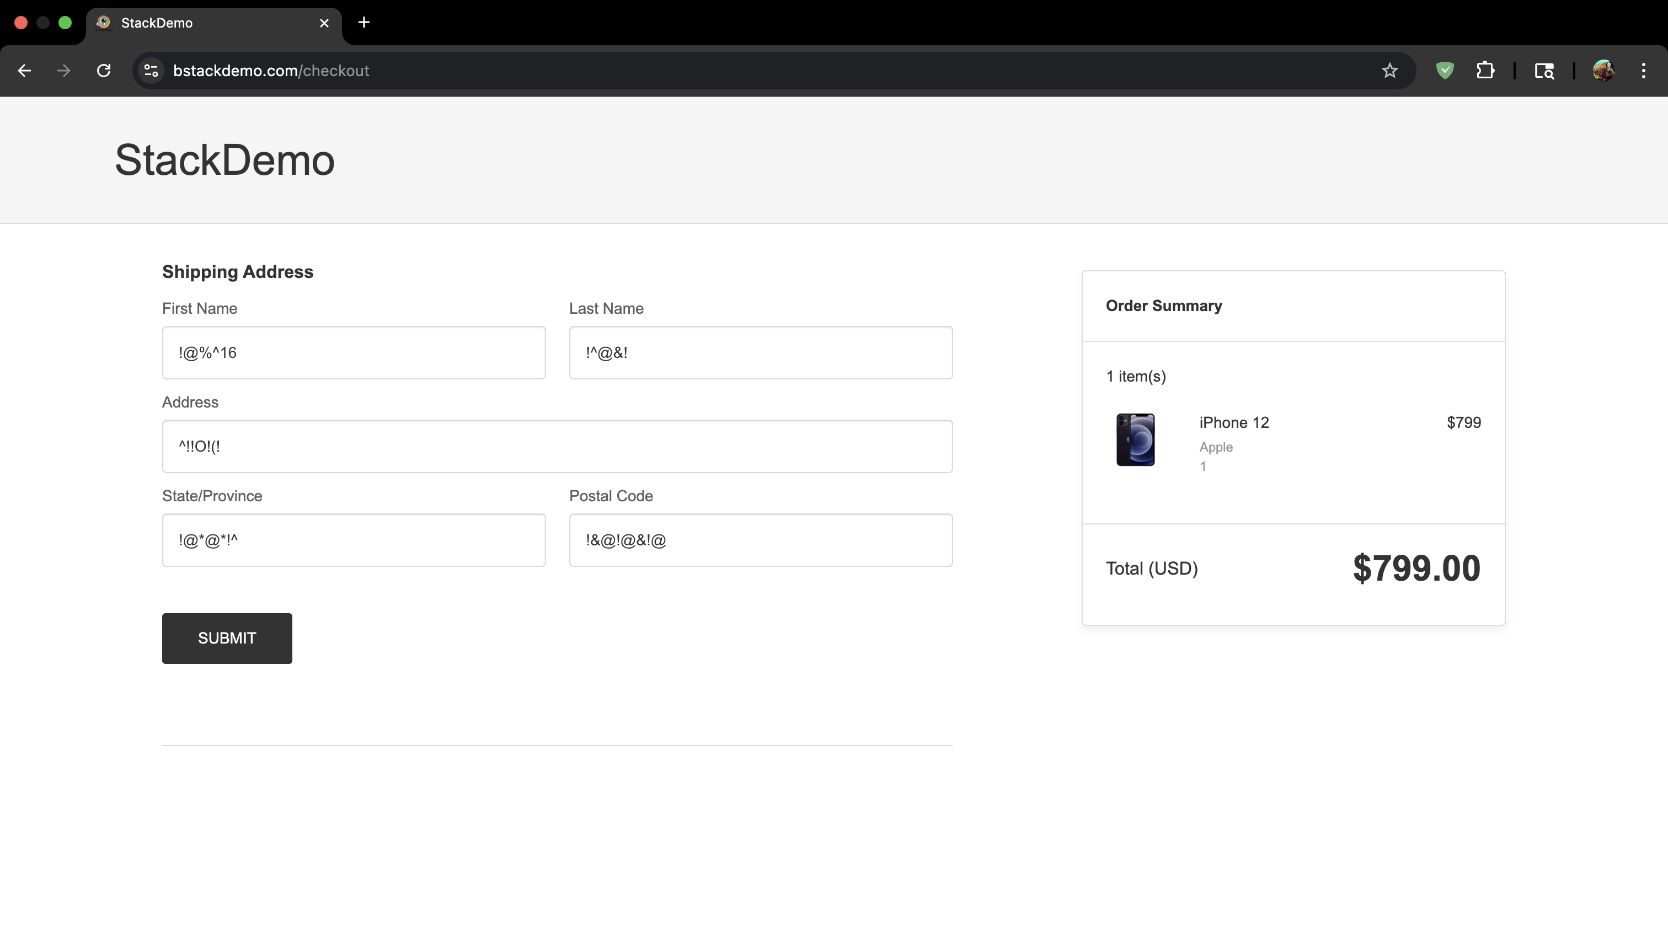

Slide 14
Defect identifier :- D_007
DEFECT SUMMARY : - Expected result is when we click on "Privacy Policy Read More" it need to navigate to the privacy policy page, but it is navigating to Homepage
TEST ID :- TC_002, TC_004
TEST CASE NAME :- TC-BStack-PP-Read More Redirect, TC-BStack-PP-Cross Browser
MODULE NAME :- Privacy Policy Read more
REPRODUCIBLE :- when we click on "Privacy Policy Read More" it need to navigate to the privacy policy page
SEVERITY :- HIGH
PRIORITY :- HIGH
RAISED BY :- G.Nasir Hussain
ASSIGNED TO :- DEVELOPER
DATE OF ASSIGNMENT :-
STATUS :- PENDING
FIXED BY :- DEVELOPER
DATE OF FIXING :-

Slide 15
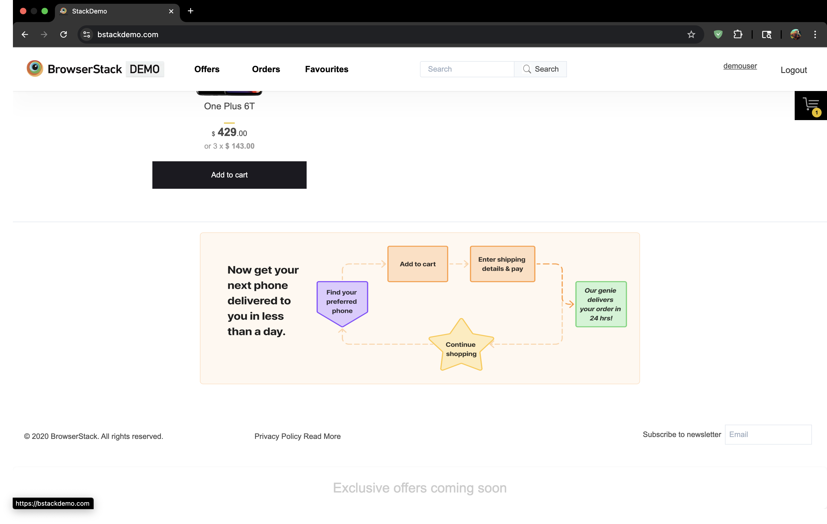

Navigating back to home page

Slide 16
CHALLENGES
FACED LOGIN CHALLENGES SO MANY TIMES DURING AUTOMATION LIKE WE CAN’T SEND KEYS IN THE USERNAME AND PASSWORD FIELDs.
GEO LOCATION FOR OFFERS SECTION AND SOME ELEMENTS WERE NOT INTERACTABLE LIKE SELECT DROPDOWN DURING AUTOMATION.

Slide 17
EXPERIENCE
GAINED HANDS-ON EXPERIENCE IN MOBILE E-COMMERCE TESTING BY WORKING ON BStack DEMO Website.
LEARNED TO WRITE AND EXECUTE AUTOMATION TEST CASES FOR PRODUCT BUYING, SEARCH, CART, AND CHECKOUT FLOWS.

Slide 18
THANK YOU
By : Guduru Nasir Hussain

